Slide 1
R Capstone Project

Slide 2
Objectives:
Top Line Questions of Interest to Senior Management:
What are the top five factors driving likelihood of churn at Mobicom?
Validation of survey findings. a) Whether “cost and billing” and “network and service quality” are important factors influencing churn behaviour. b) Are data usage connectivity issues turning out to be costly? In other words, is it leading to churn?
Would you recommend rate plan migration as a proactive retention strategy?
What would be your recommendation on how to use this churn model for prioritisation of customers for a proactive retention campaigns in the future?
What would be the target segments for proactive retention campaigns? Falling ARPU forecast is also a concern and therefore, Mobicom would like to save their high revenue customers besides managing churn. Given a budget constraint of a contact list of 20% of the subscriber pool, which subscribers should prioritized if “revenue saves” is also a priority besides controlling churn. In other words, controlling churn is the primary objective and revenue saves is the secondary objective.

Slide 3
The top five factors driving likelihood of churn at Mobicom
* Age of the current equipment- Positively correlated with churn.
* Retention calls: The customer who are not received any retention calls are more likely to churn.
*Unique Subscribe7-if no of unique subscriber increase in the house hold to level 7 then the pprobability of churn also increase by 0.69 unit So spatial focus should be givenFamily with 7 unique subscriber. Family bundle pack may reduce churn
*Unique Subscriber4- if no of unique subscriber increse in the house hold to level 4 then the probability of churn also increase by 0.31 unit So spatial focus should be given family with 4 unique subscriber. Family bundle pack/ spatial offer may reduce churn.

Slide 4
Validation of survey findings. a) Whether “cost and billing” and “network and service quality” are important factors influencing churn behaviour. b) Are data usage connectivity issues turning out to be costly? In other words, is it leading to churn?
a) Whether "cost and billing" and "network and service quality" are important factors influencing churn behaviour.
"cost and billing" can be explain by the variable totmrc_mean, oveage, totrev
totmrc_mean
Monthly the base cost of the calling plan regardless of actual minutes used
A unit increse in totmrc_Mean causing 0.005 unit decrese in churn
Unit increase in overage leads to 0.64 unit increase in churn
Unit increase in total revenue causes 0.0002 unit increase in churn
Other than overage the "cost and billing" has no impact on churn.
Overage billing can be decrease by offering optimal plan to the customer

Slide 5
b) Are data usage connectivity issues turning out to be costly? In other words, is it leading to churn?
following variable can explain data usage connectivity
drop_dat_mean - Mean no of dropped/ failed data calls.
datovr_Mean - Mean data overage Revenue.
datover_Range - Mean overage Revenue.
blck_dat_Mean - Mean no of blocked/failed data calls
plcd_dat_Mean - Mean number of attempted data calls placed
Comp_dat_Mean - Mean no of completed data calls
opk_dat_Mean - Mean no. of off-peak data calls
From Quality Report we can conclude that data call placed by only 9 to 15% of the customes.
Only few customers are using internet so we dont have enough observation to conclude that data connectivity leading to churn.
Data connectivity are not showing any impact on churn.

Slide 6
Would you recommend rate plan migration as a proactive retention strategy?
Overage: ovrrev_Mean/totrev signifies that if overage cost increase by 1 unit, there is 0.65 unit increase in churn.
Overage is the result for non optimal plan.
Rate plan migration should be a proactive retention strategy.

Slide 7
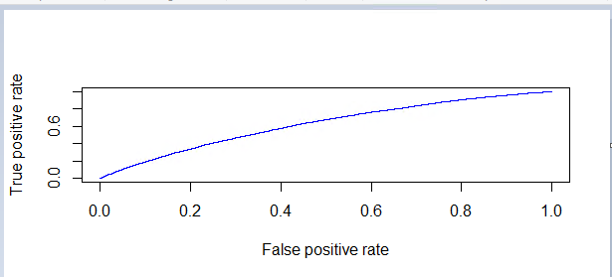
ROCR Curve

Slide 8
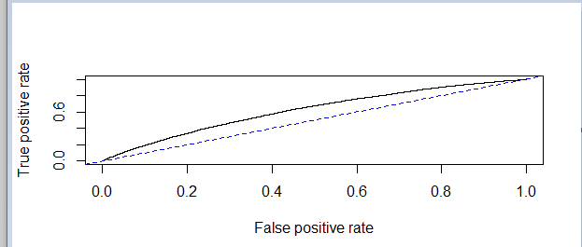
abline(0,1,lty=8,col="red")
This function adds one or more straight lines through the current plot.

Slide 9
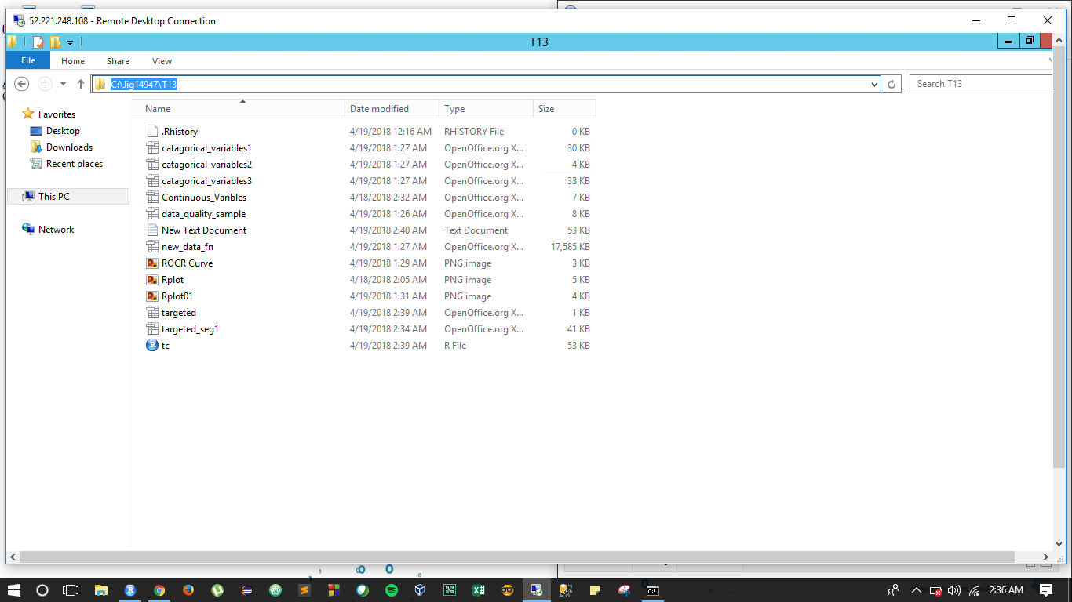
Path :- C:\Jig14947\T13\tc.r

Slide 10
Thank You

